Slide 1
Stream Processing Live Traffic Data with Kafka Streams

Slide 2

Who am I
Tom Van den Bulck
Principal Java Software Engineer @ Ordina
@tomvdbulck

Slide 3
Brought to you by

Slide 4


Slide 5
What is Kafka
High volume publish-subscribe message and streams
Durable
Fast
Scalable

Slide 6

History
LinkedIn
Open sourced in 2011
Confluent
Founded by the creators of kafka
Notes:
Handles trillions of messages a day at LinkedIn

Slide 7

Some terms
Brokers
Controller
Zookeeper
Partitions
Replicas
Producers
Consumers

Slide 8
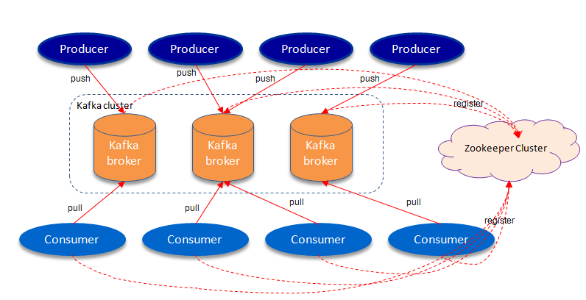
Brokers

Slide 9
Brokers
The nodes
Store all the messages
These are dumb

Slide 10
Controller
Only 1 broker is the controller
Kafka Controller Election: relies on Zookeeper
Manages the state of partitions and replicas
Reassigns partitions (master of the partition)

Slide 11

Zookeeper
Service Discovery
Electing a Controller
Cluster Membership
Topic Configuration
Notes:
Pretty important to know the state of affairs

Slide 12
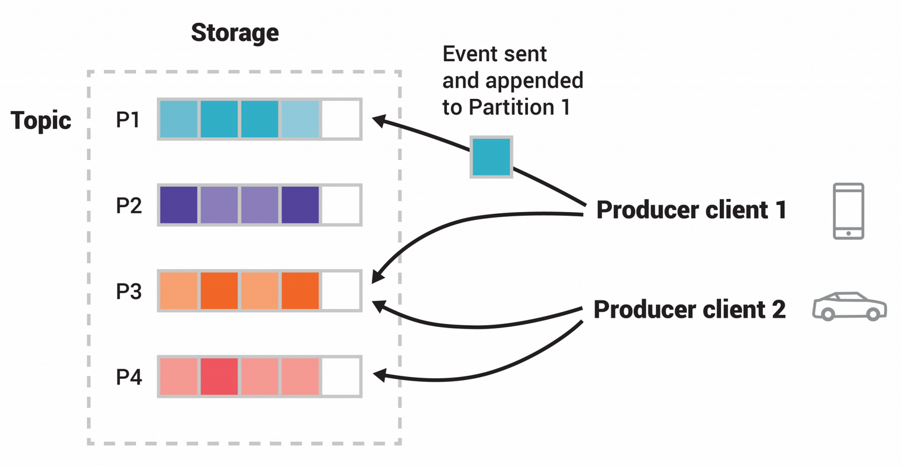
Topics

Slide 13
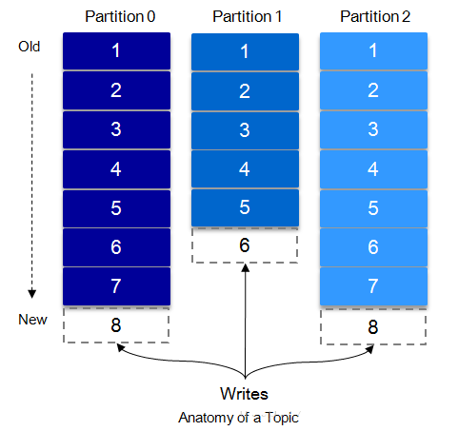
Topics

Slide 14
Partition
Topics are split in partitions
1 broker is leader
Used to scale

Slide 15
Partition - rebalancing
Default is auto-balancing
auto.leader.rebalance.enable: true
Pay attention for the partition key

Slide 16
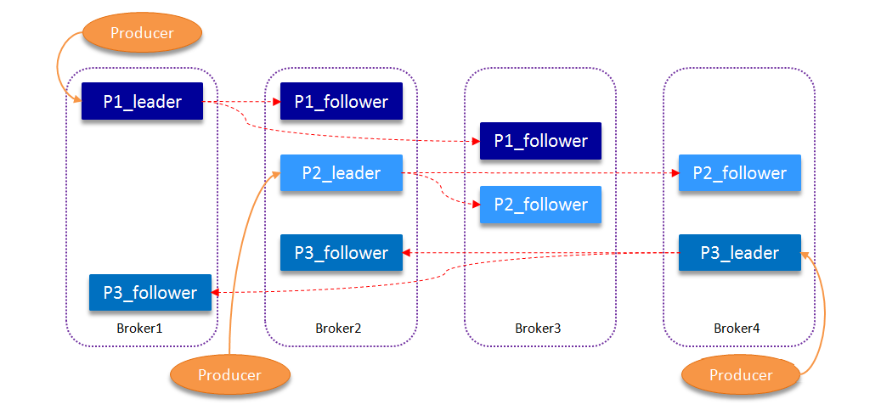
Replication

Slide 17
Replication
Fail Over
Every brokers has list of In Sync Replicas
Kept in sync with master

Slide 18
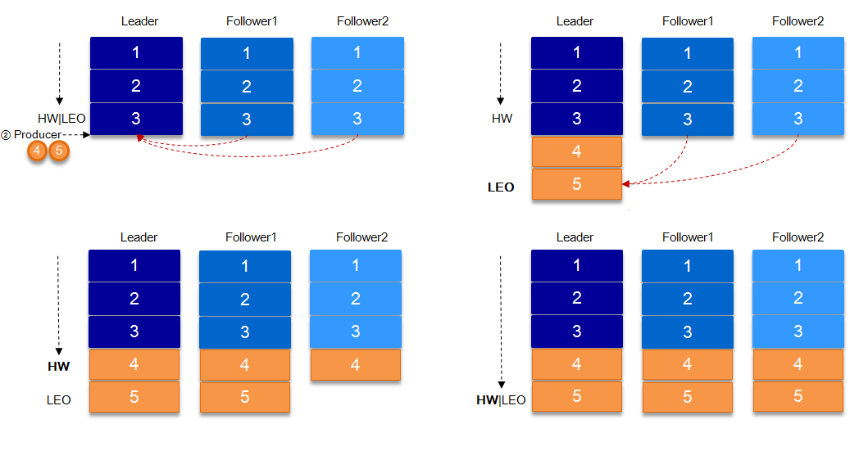
Replication: ISR
Notes:
The above section also refers to a concept, HW. HW commonly known as high water level, take a partition corresponding to the smallest of the ISR LEO(Log End Offset) as HW, consumer can only consume the HW where the location. In addition, each replica has HW, leader and follower are responsible for updating their HW status. For the newly written message of the leader, the consumer cannot consume it immediately. The leader will wait for the message to be updated after all the replicas in the ISR have been synchronized.

Slide 19
Replication: all die
Wait until an ISR replica is back
Or choose the first one – you will/might lose some messages

Slide 20
Replication: acknowledgement
0, 1 or all (ISR)
Only for producers
To lose or not to lose

Slide 21
Producer
Push messages to Kafka topics
Will be forwarded to master broker
Can pass along a partition key

Slide 22
Message
Unique offset within a partition
Remain until TTL (time to live) or after compaction

Slide 23
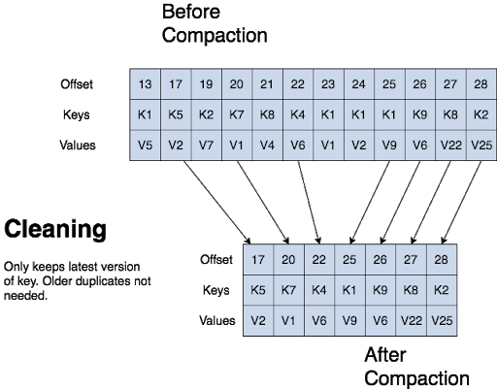
Log Compaction

Slide 24
Log Compaction
Compaction does require proper key use
Runs in the background
Side note: GDPR and encrypting privacy related data

Slide 25
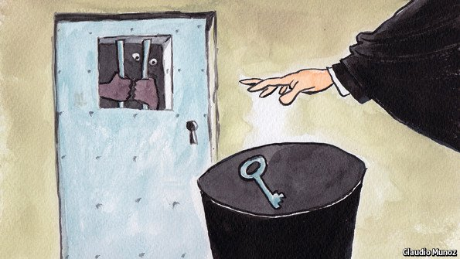

Log Compaction: Side Note
Notes:
If you encrypt GDPR data (and throw away the key of the person when that person wants to be forgotten)
Also make sure that you compact it and throw that data out – it is pretty stupid to keep it alive in your topics

Slide 26
Consumers
Read messages from specific offset
Asks for messages – pull based
So no risk of overloading a consumer
Can only read message which are in sync

Slide 27
Consumer: offset
Stored in Kafka – per partition / consumer group
Exactly once: read and commit offset in transaction
Note: the standard kafka consumer client also retains the last read offset in memory
Notes:
Stored in a specific kafka topic: _consumer_offsets

Slide 28
Consumer Group
1 partition can be read by 1 consumer of the group
Enables parallel processing
# Partitions determines max # consumers!
Notes:
https://spring.io/blog/2021/02/03/demystifying-spring-cloud-stream-producers-with-apache-kafka-partitions

Slide 29

Not Enough Partitions!!!
Notes:
https://spring.io/blog/2021/02/03/demystifying-spring-cloud-stream-producers-with-apache-kafka-partitions

Slide 30
Not Enough Partitions!!!
Can be increased manually
Or via Spring Cloud Stream’s binding
Or topic operators
Notes:
https://spring.io/blog/2021/02/03/demystifying-spring-cloud-stream-producers-with-apache-kafka-partitions

Slide 31

Consumers: Need Brains

Slide 32
Consumers: Need Brains in order to
commit/rollback offsets
deal with external systems (transactions)
pull the messages
Note: kafka streams is a client/consumer
Notes:
For example with MQ you have: More control/guarantees per-message. Complex routing to consumers. More variety in: point to point, request/reply and publish/subscribe messaging

Slide 33
Kafka: Disadvantages vs MQ
Operations not that easy
Security
You want to have more complex routing to consumers
Point to point
Request/reply
Publish/subscribe
Notes:
For example with MQ you have: More control/guarantees per-message. Complex routing to consumers. More variety in: point to point, request/reply and publish/subscribe messaging

Slide 34
Kafka: Advantages vs MQ
Performance
Ease to connect new consumers and producers
It is more like a database with streaming capabilities
Notes:
For example with MQ you have: More control/guarantees per-message. Complex routing to consumers. More variety in: point to point, request/reply and publish/subscribe messaging

Slide 35
Kafka: Advantages vs MQ
Performance
Ease to connect new consumers and producers
It is more like a database with streaming capabilities
Notes:
For example with MQ you have: More control/guarantees per-message. Complex routing to consumers. More variety in: point to point, request/reply and publish/subscribe messaging

Slide 36

Kafka
Notes:
It will hold the data for you
For as long as the producer wants you to have that data and it will

Slide 37
Kafka
Will hold the data
For as long as the producers allows it
It will make sure that you can get it as fast as possible
Notes:
It will hold the data for you
For as long as the producer wants you to have that data and it will

Slide 38
Kafka: Connector
Ready to use
To access external systems
Notes:
It will hold the data for you
For as long as the producer wants you to have that data and it will

Slide 39
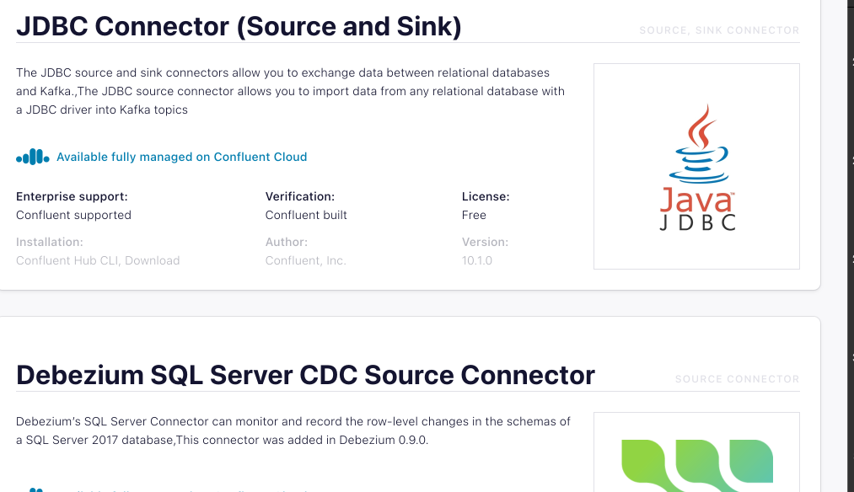
Kafka: Connector – Source
Collect data from a system
Notes:
It will hold the data for you
For as long as the producer wants you to have that data and it will

Slide 40
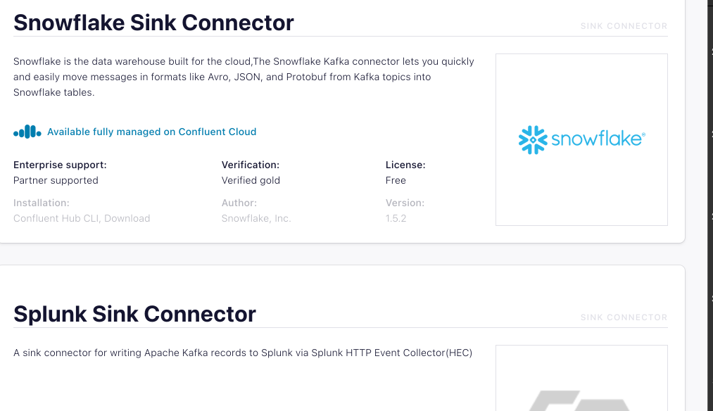
Kafka: Connector – Sink
Deliver data to other systems
Notes:
It will hold the data for you
For as long as the producer wants you to have that data and it will

Slide 41
Exactly Once
Transactions
External System
Partition Keys

Slide 42
Exactly Once: Transactions
Possible to work with transactions
Transaction only guaranteed within Kafka
Does work with Kafka Streams
Notes:
https://www.confluent.io/blog/transactional-systems-with-apache-kafka/ https://www.baeldung.com/kafka-exactly-once https://github.com/spring-cloud/spring-cloud-stream-binder-kafka/issues/858

Slide 43

Exactly Once: External System
DIY
Use a database and message ids
Notes:
https://www.confluent.io/blog/transactional-systems-with-apache-kafka/

Slide 44
Exactly Once: Partition Keys
Kafka guarantees ordering within a partition
Different partitions: can be out of order
Notes:
https://www.confluent.io/blog/transactional-systems-with-apache-kafka/

Slide 45
Setup Environment
https://github.com/tomvdbulck/kafka-workshop

Slide 46
Setup Environment
Go to the readme and start up your kafka.
Next we will move to lab1.md

Slide 47
Lab 1
Show you topic creation:
Isr
Partitions
replicas

Slide 48
Lab 1
Produce a message
Consume Messages
From start
From a specific offset
Pass along a consumer group id would also be possible:

Slide 49

Practical: lab1

Slide 50
Practical: lab1

Slide 51
Consumer Groups
A way to scale
1 partition can only be assigned to 1 consumer of a consumer group.
Easy: just pass along the group.id when consuming
The kafka consumer will make it happen.

Slide 52
Kafka and Java
Native
Spring Kafka
Spring Cloud Stream

Slide 53
What
Notes:
The old days:
Query in order to retrieve data you need
The glorious time of the batch jobs

Slide 54
What
Notes:
Reacts on Events
Events should be as complete as possible
Continuous stream

Slide 55
What: Event
Data it owns
Data it needs
References data
Notes:
Data it owns: this is data tied owned by the publisher in the event
Data it needs: this is data which can originate from other services but which is necessary to handle the event
Referenced Data: data which might be relevant for the event. For example when booking a holiday, the reference temperatures of the location to where you want to travel to. Example contract update: owns: new price / needs: contract data, old price, discounts, …. / references: customer data to contact customer

Slide 56
What: Streaming
Reacts on events
Continuously
Notes:
Shorter feedback loop: fraud detection, much nicer feedback to the customers, …

Slide 57
Why
Much shorter feedback loop
More resource efficient
Stream processing feels more natural
Decentralize and decouple infrastructure
Notes:
Much shorter feedback for your business users
Because you are processing smaller sets of data at the same time resources can be used more efficiently
Stream processing tends to feel more natural, as most data also enters your system as a stream
There is no longer a need for large and expensive databases, each stream processing application maintains its own data and state And each application also tends to decide itself what it will consume

Slide 58
The Data

Slide 59
The Data
Every minute XML is generated
So it is not the raw data
Be aware:
Dutch words

Slide 60
The Data
XML with fixed sensor data
<meetpunt unieke_id="3640"> <beschrijvende_id>H291L10</beschrijvende_id> <volledige_naam>Parking Kruibeke</volledige_naam> <Ident_8>A0140002</Ident_8> <lve_nr>437</lve_nr> <Kmp_Rsys>94,695</Kmp_Rsys> <Rijstrook>R10</Rijstrook> <X_coord_EPSG_31370>144477,0917</X_coord_EPSG_31370> <Y_coord_EPSG_31370>208290,6237</Y_coord_EPSG_31370> <lengtegraad_EPSG_4326>4,289767347</lengtegraad_EPSG_4326> <breedtegraad_EPSG_4326>51,18458196</breedtegraad_EPSG_4326> </meetpunt>

Slide 61
The Data
XML with dynamic traffic data
<meetpunt beschrijvende_id="H222L10" unieke_id="29"> <lve_nr>55</lve_nr> <tijd_waarneming>2018-11-03T14:43:00+01:00</tijd_waarneming> <tijd_laatst_gewijzigd>2018-11-03T14:44:24+01:00</tijd_laatst_gewijzigd> <actueel_publicatie>1</actueel_publicatie> <beschikbaar>1</beschikbaar>

Slide 62
The Data
XML with dynamic traffic data
<meetdata klasse_id="4"> <verkeersintensiteit>2</verkeersintensiteit> <voertuigsnelheid_rekenkundig>60</voertuigsnelheid_rekenkundig> <voertuigsnelheid_harmonisch>59</voertuigsnelheid_harmonisch> </meetdata>

Slide 63
The Data
XML with dynamic traffic data
/* Note: the vehicle class MOTO(1), does not provide reliable data. */ MOTO(1), CAR(2), CAMIONET(3), // a VAN RIGGID_LORRIES(4), TRUCK_OR_BUS(5), UNKNOWN(0);

Slide 64
The Data
XML with dynamic traffic data
<meetdata klasse_id="3"> <verkeersintensiteit>0</verkeersintensiteit> <voertuigsnelheid_rekenkundig>0</voertuigsnelheid_rekenkundig> <voertuigsnelheid_harmonisch>252</voertuigsnelheid_harmonisch> </meetdata>
Notes:
No traffic data for that lane and vehicle type … so we say that the vehicle speed is 252 …

Slide 65
The Data: Some Lessons
Think about the language
Think about the values you are going to output
252 when no readings
254 when an error occurred

Slide 66
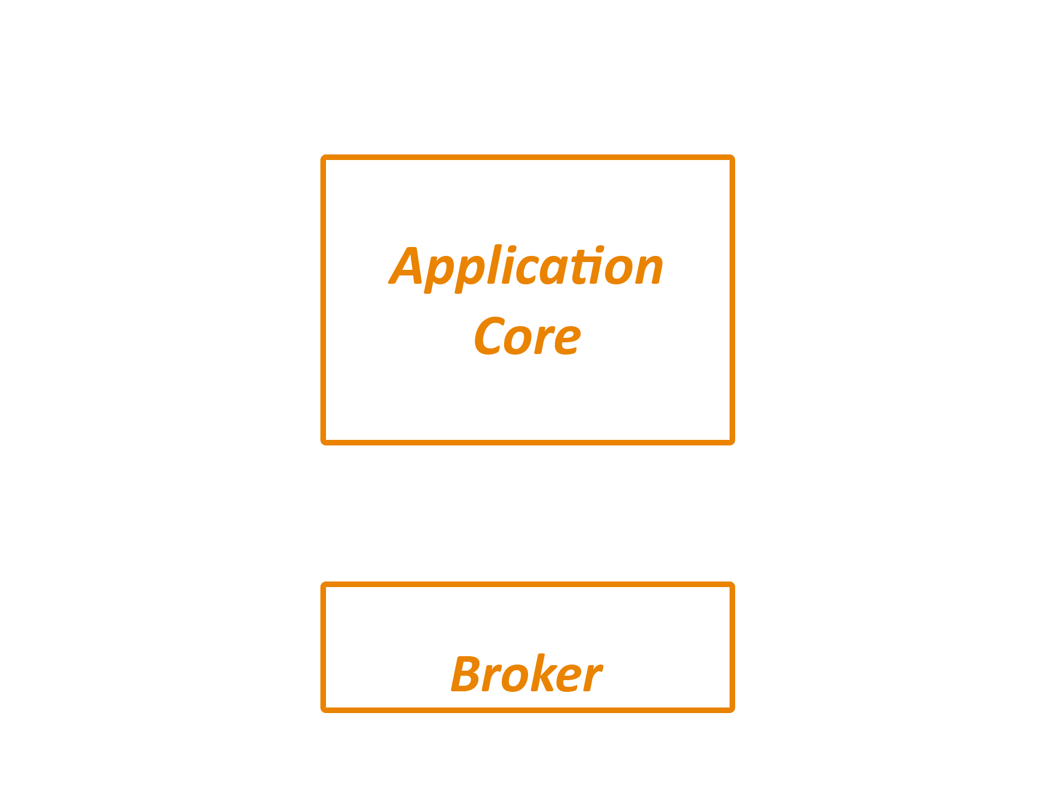
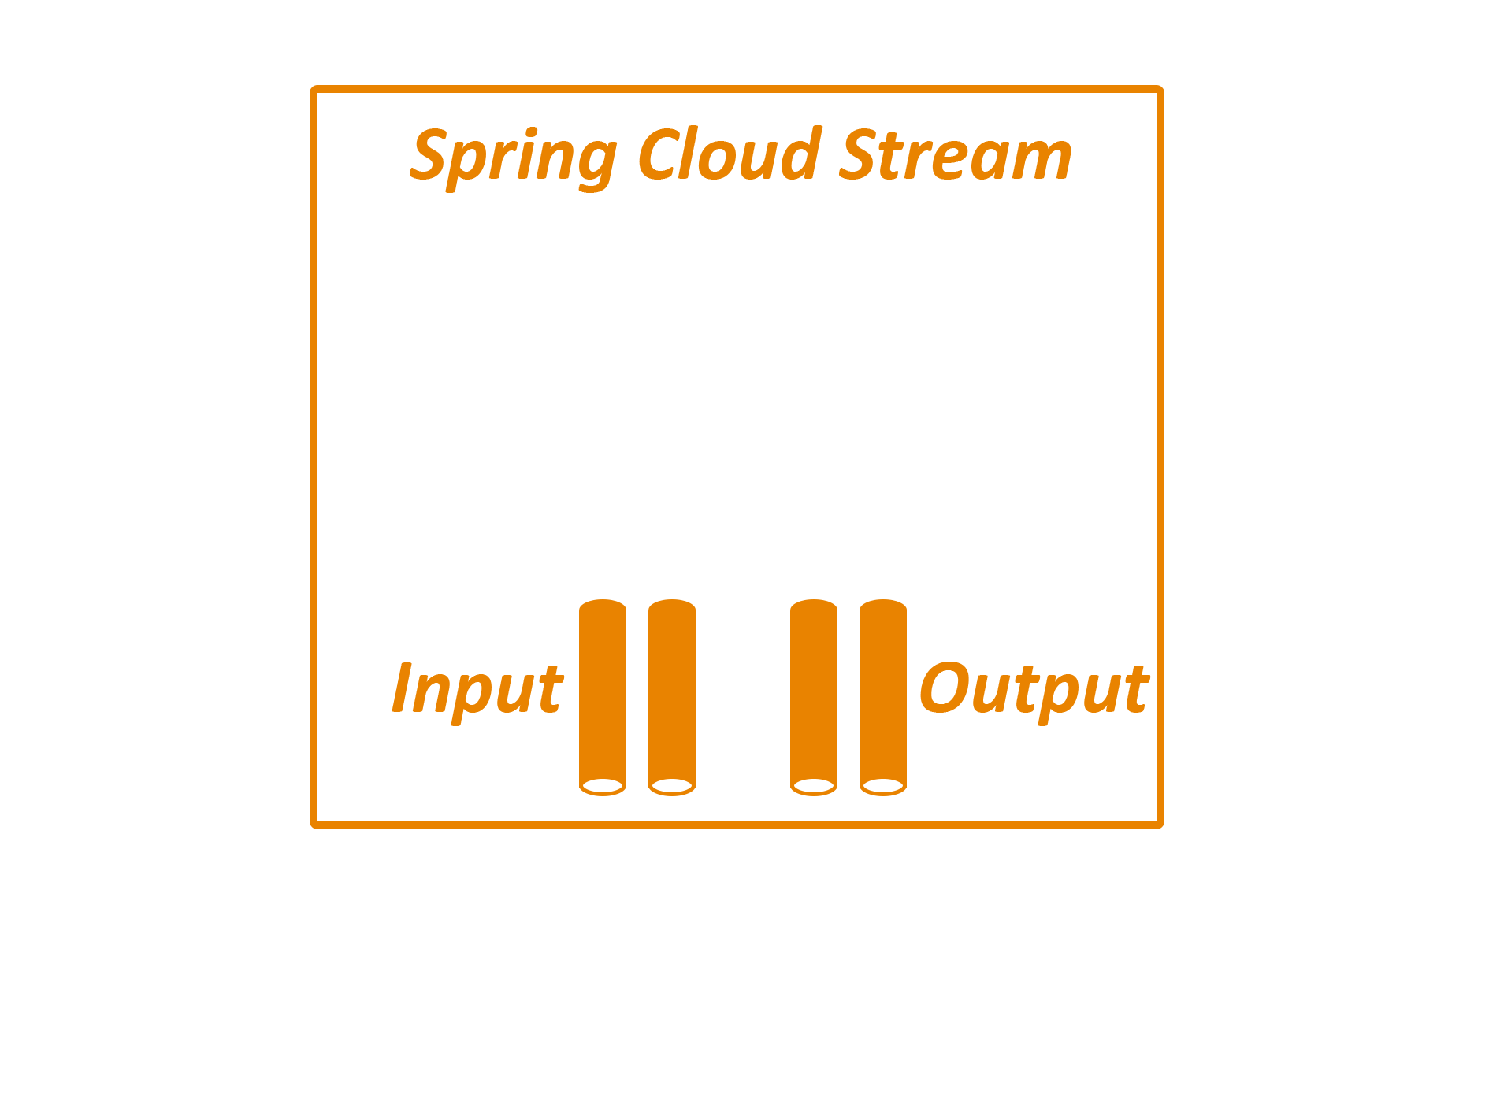
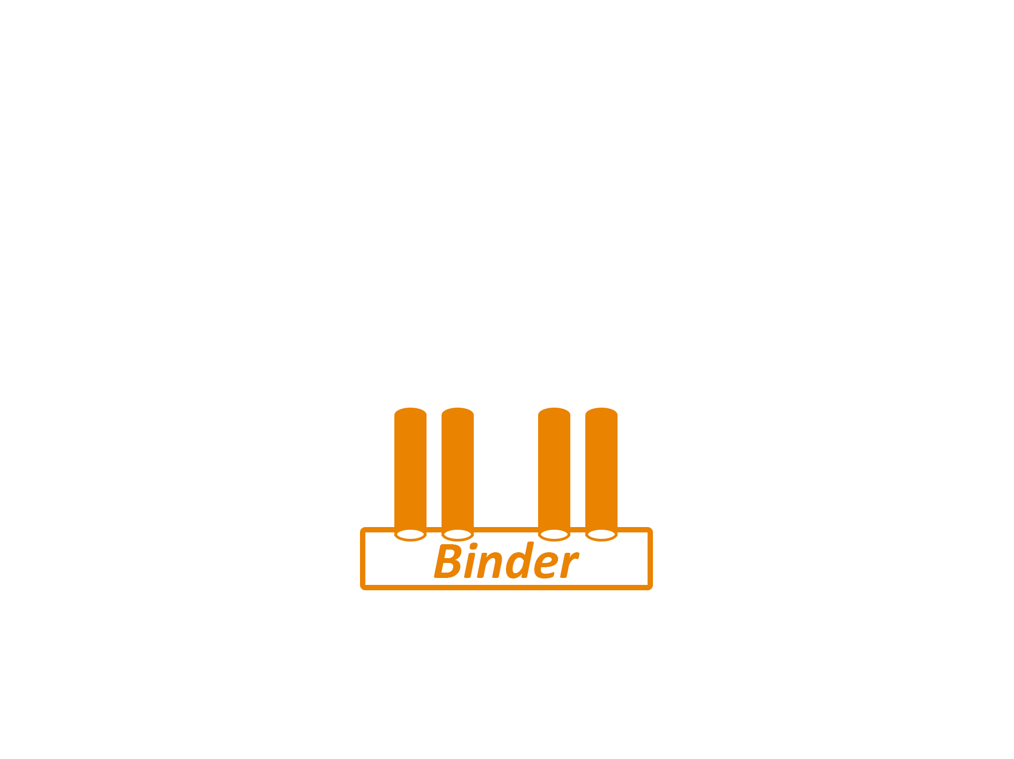
How

Slide 67
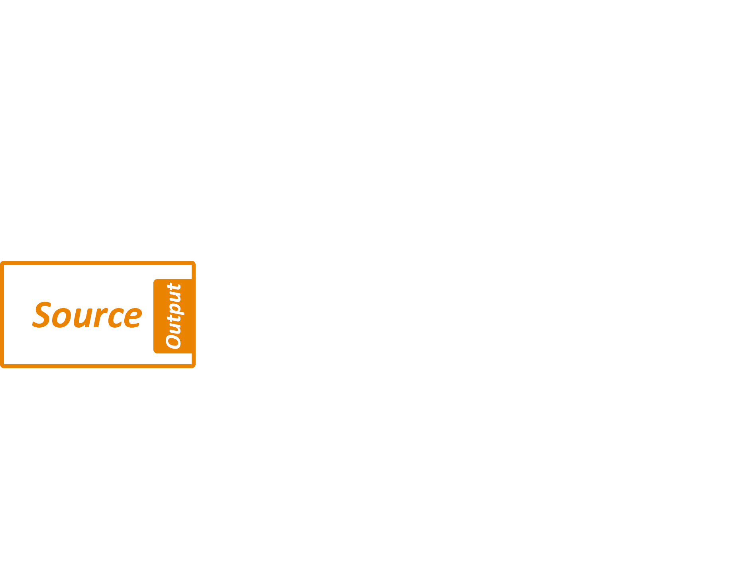
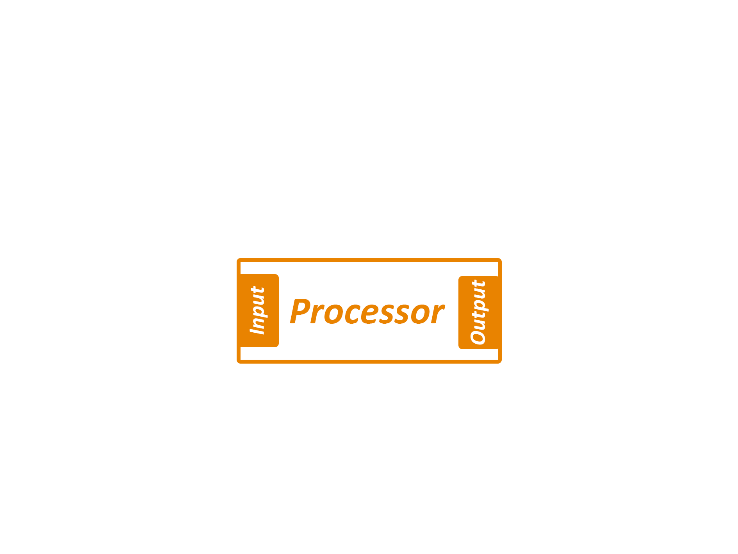
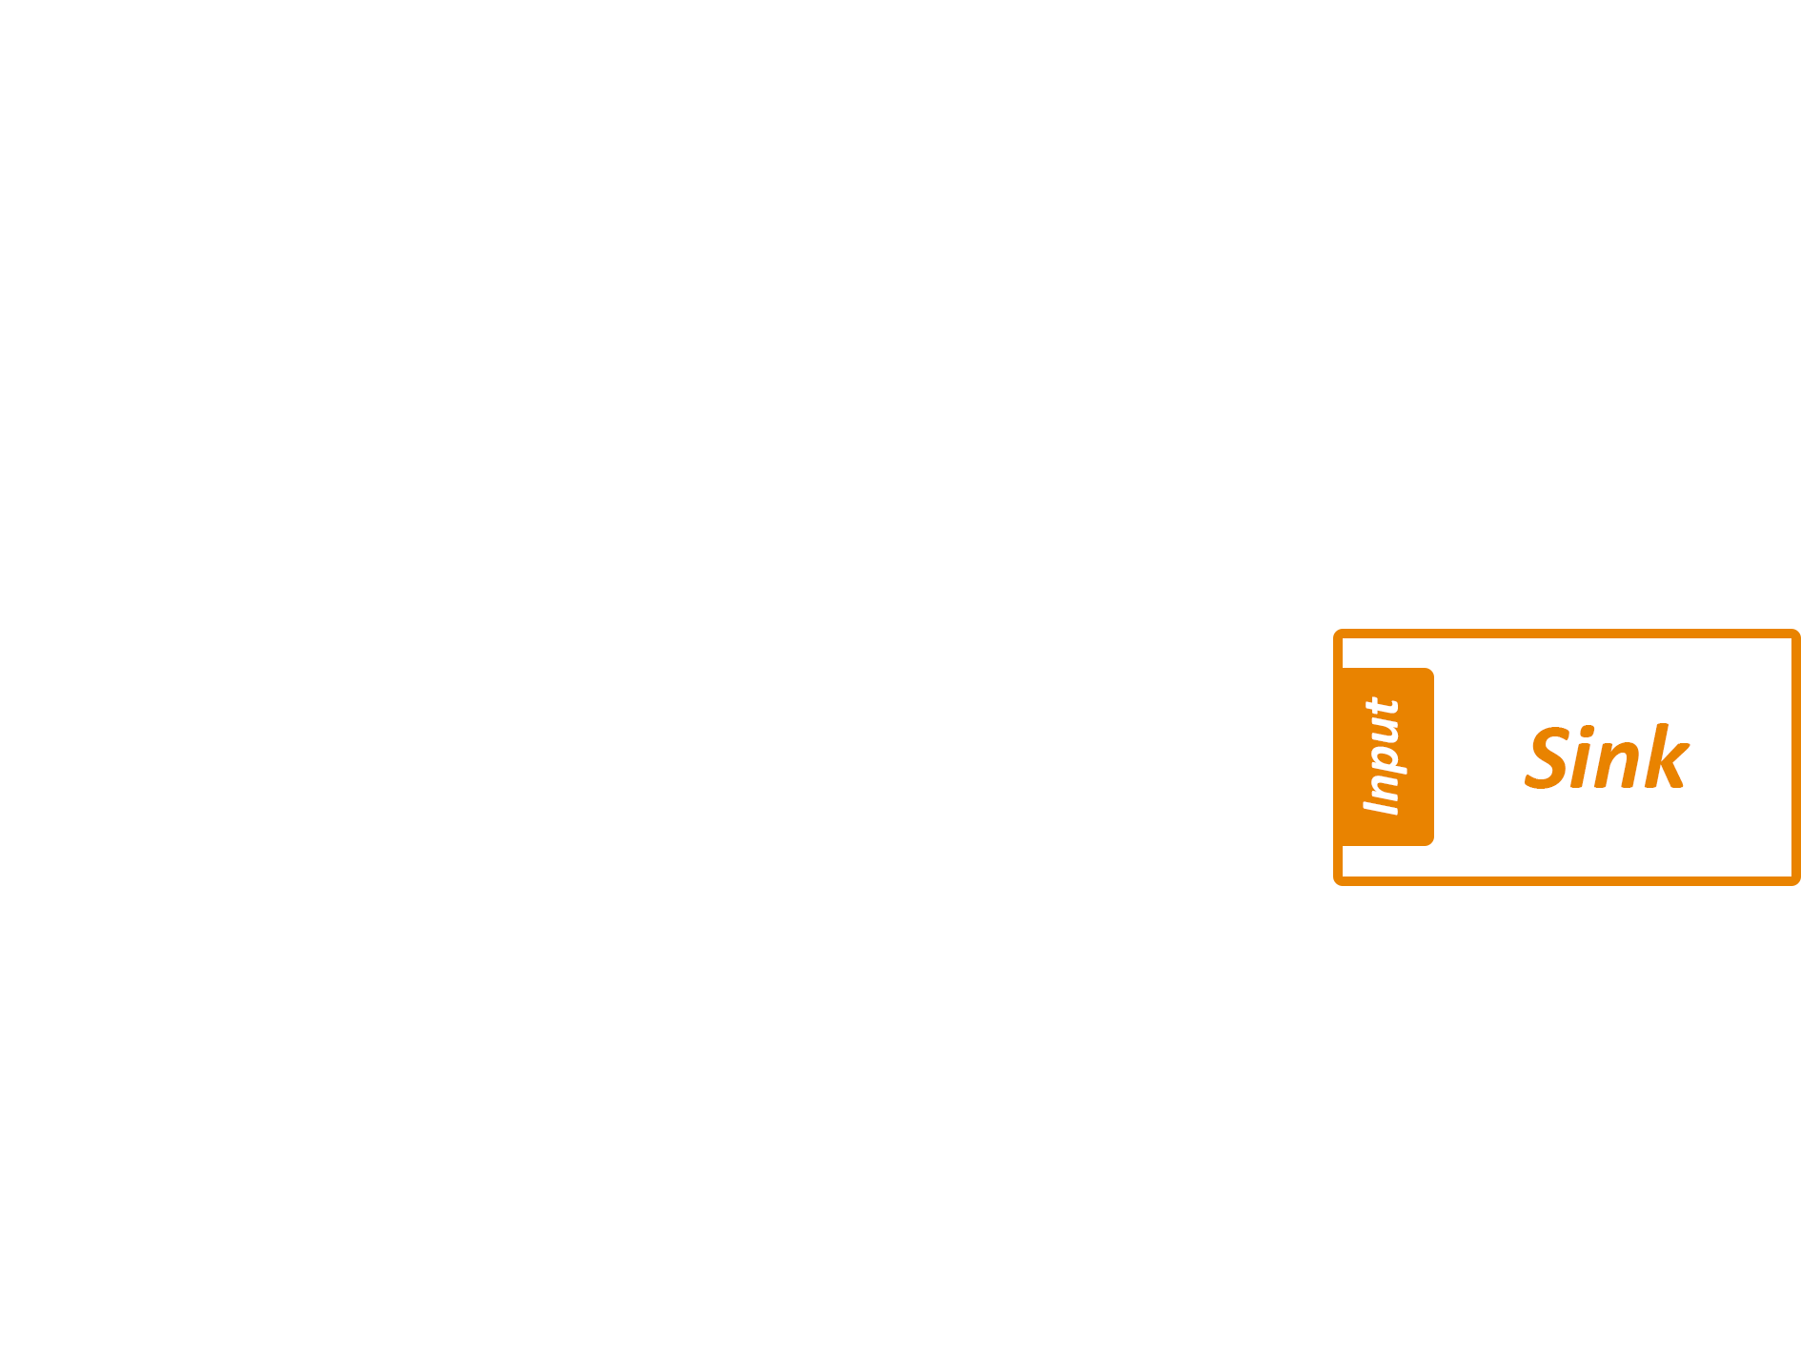
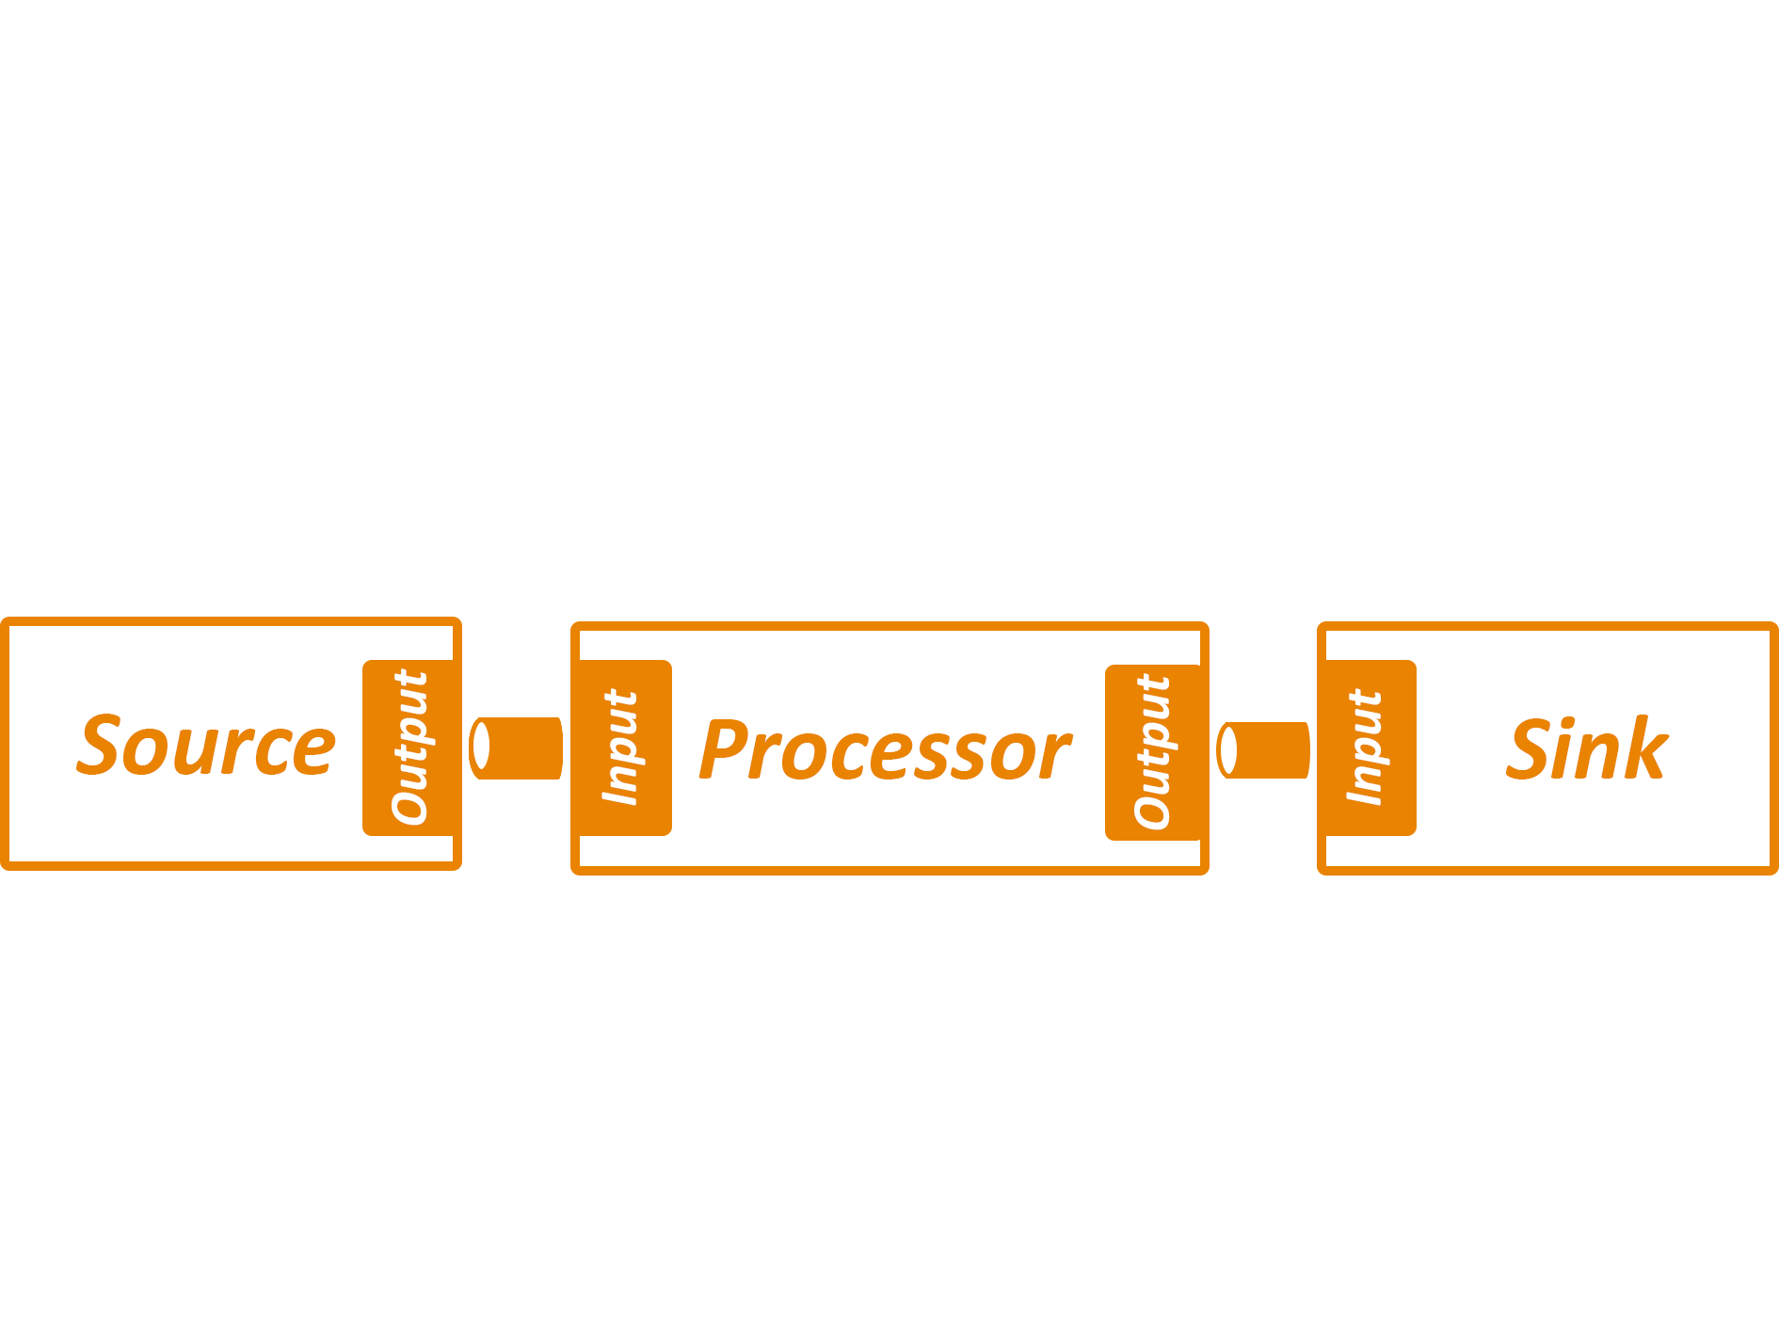
How

Slide 68
Practical: lab2

Slide 69
Lab 2: Send events to Kafka - Imperative
Dependencies
spring-cloud-starter-stream-kafka
Added @EnableBinding
Properties:
spring.cloud.stream.bindings.output.destination=traffic-data

Slide 70
Lab 2: Send events to Kafka
Don’t use @Scheduling for use cases like this in production
Bad practice, use batch jobs: eg. Spring Cloud Task or K8s CronJob!

Slide 71
Practical: lab3

Slide 72
Lab 3: Intake of data from Kafka
@EnableBinding
@StreamListener(Sink.INPUT)
Properties:
spring.cloud.stream.bindings.input.destination=traffic-data

Slide 73
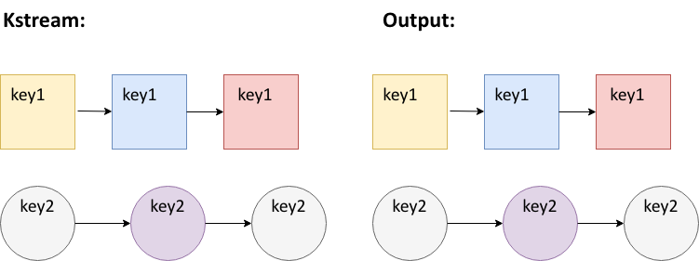
Native streaming: KStream

Slide 74
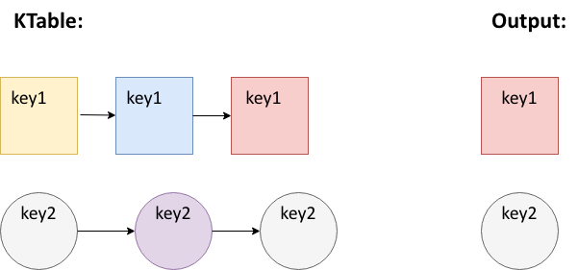
Native streaming: KTable

Slide 75
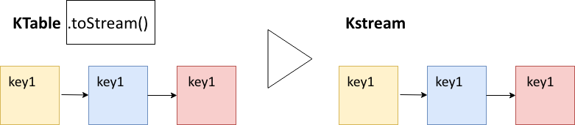
Native streaming operations: toStream

Slide 76
Native streaming operations: Stateless
No need of a state store for these operations

Slide 77
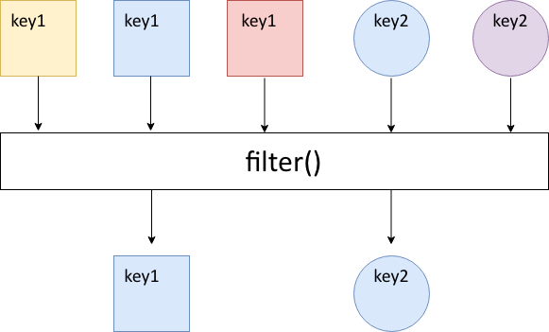
Native streaming operations: filter

Slide 78
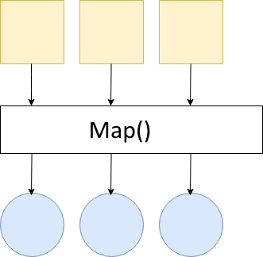
Native streaming operations: map

Slide 79
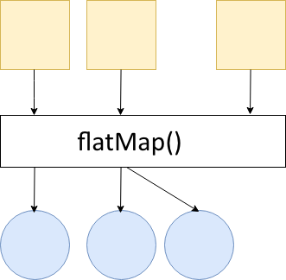
Native streaming operations: flatMap
Notes:
Every record processed can result in 0, 1 or more new records

Slide 80
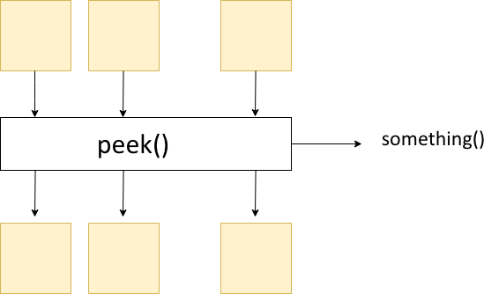
Native streaming operations: peek

Slide 81
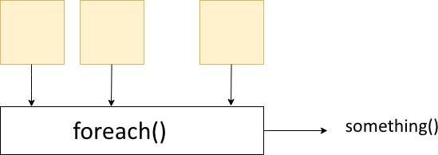
Native streaming operations: forEach

Slide 82
Native streaming operations: Stateless
selectKey
filter
map/mapValues
flatMap/flatMapValues
peek
forEach
groupByKey
toStream

Slide 83
Practical: lab4a

Slide 84
Lab 4a: Stateless
Dependencies
spring-cloud-stream-binder-kafka-streams
Added custom interface: KStreamSink
Methods used
.filter
.print
Updated configuration:
spring.cloud.stream.default-binder=kafka
spring.cloud.stream.bindings.native-input.binder=kstream

Slide 85
Native streaming operations: stateful
State store is used
In memory database
RocksDB
Fault-Tolerant: replicated changelog topic in Kafka
Notes:
These data store can also be used by other processors

Slide 86
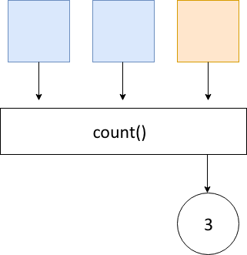
Native streaming operations: count

Slide 87
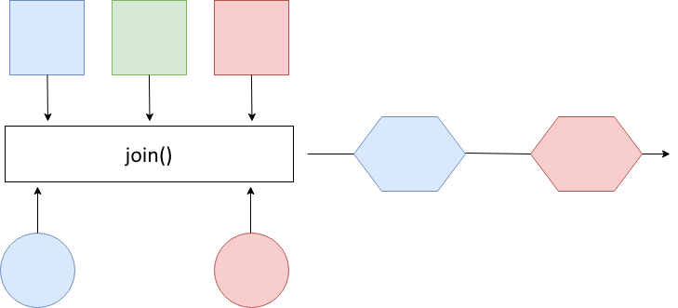
Native streaming operations: joining

Slide 88
Native streaming operations: groupByKey
Groups records in KGroupedStream
Required before aggregation operations
Writes data to new topic (might repartition)

Slide 89
Native streaming operations: aggregations
Transforms groupedKStream to Ktable
Need Initializer: aggValue = 0
Operation: “adder”: aggValue + oldValue

Slide 90
Native streaming operations: stateful
groupByKey (still stateless)
count
aggregations
joining
windowing

Slide 91
Windows
Tumbling
Sliding
Session

Slide 92
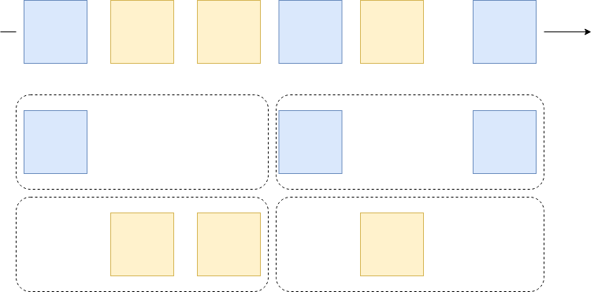
Tumbling

Slide 93
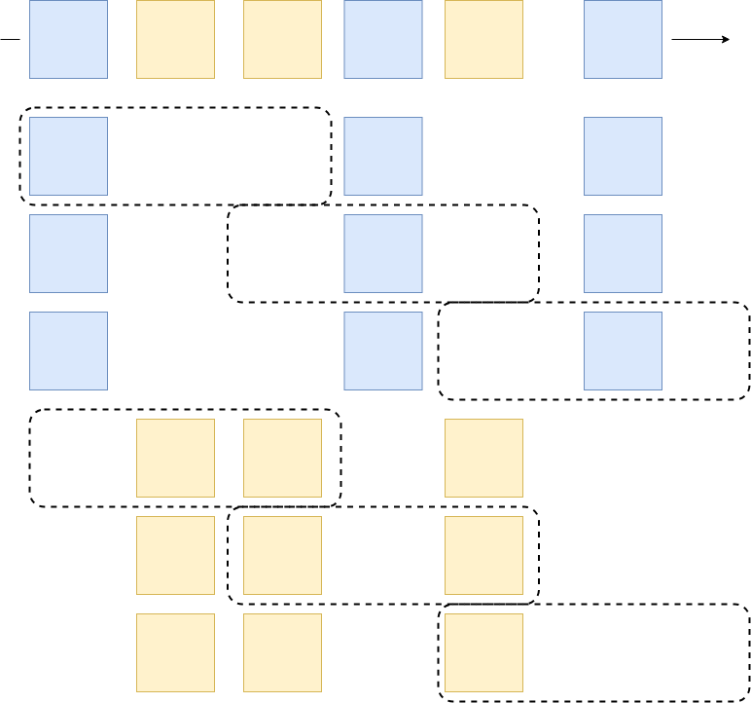
Sliding

Slide 94
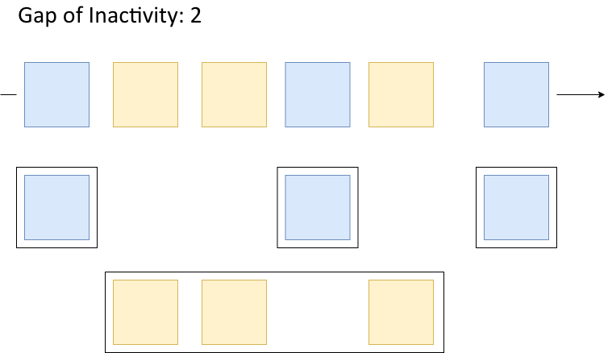
Session windows

Slide 95
Session windows
Limited by an inactivity gap
Be aware: the data you need to process might grow

Slide 96
Practical: lab4b

Slide 97
Lab 4b: Windows & Statefull

Slide 98
Lab 4b: Windows & Statefull
GroupByKey
Use of SerDe (StringSerde and JsonSerde)

Slide 99
Lab 4b: Windows
Methods used
.windowedBy
.aggregate
Use of aggregator class
Materialized with
.mapValues: convert records
.toStream: Convert KTable to KStream

Slide 100

Monitoring
Notes:
https://docs.confluent.io/platform/current/kafka/monitoring.html

Slide 101
Monitoring: Broker
Isr
Metrics around in sync replicas
Under-replicated partitions
Unprefered Leaders
Network throughput
Transmit, receive, disk I/O, disk space and CPU

Slide 102
Monitoring: Consumer
Lag
The # of messages a consumer is behind the offset

Slide 103
Monitoring: Producer
Retries
Failures
Notes:
https://www.splunk.com/en_us/blog/devops/how-we-monitor-and-run-kafka-at-scale.html

Slide 104
Monitoring: Zookeeper
Just make sure it is alive

Slide 105
Kafka Properties – great source
https://kafka.apache.org/documentation/#configuration
Notes:
https://newrelic.com/blog/best-practices/kafka-best-practices

Slide 106

Schema Registry
Apache Avro (was the original one)
ProtoBuf
JSON Schema
Notes:
https://docs.confluent.io/platform/current/schema-registry/serdes-develop/serdes-avro.html
https://developers.google.com/protocol-buffers/
https://json-schema.org/

Slide 107
Schema Registry
More explicit message schemes
Brokers can use schema validation
Cleaner to put different messages of the same aggregate on a topic
Create
Update
Delete
(use partition key to guarantee ordering of events)
Notes:
https://docs.confluent.io/platform/current/schema-registry/schema-validation.html#

Slide 108
Testing
Spring Kafka (Tools)
Test containers
Docker

Slide 109
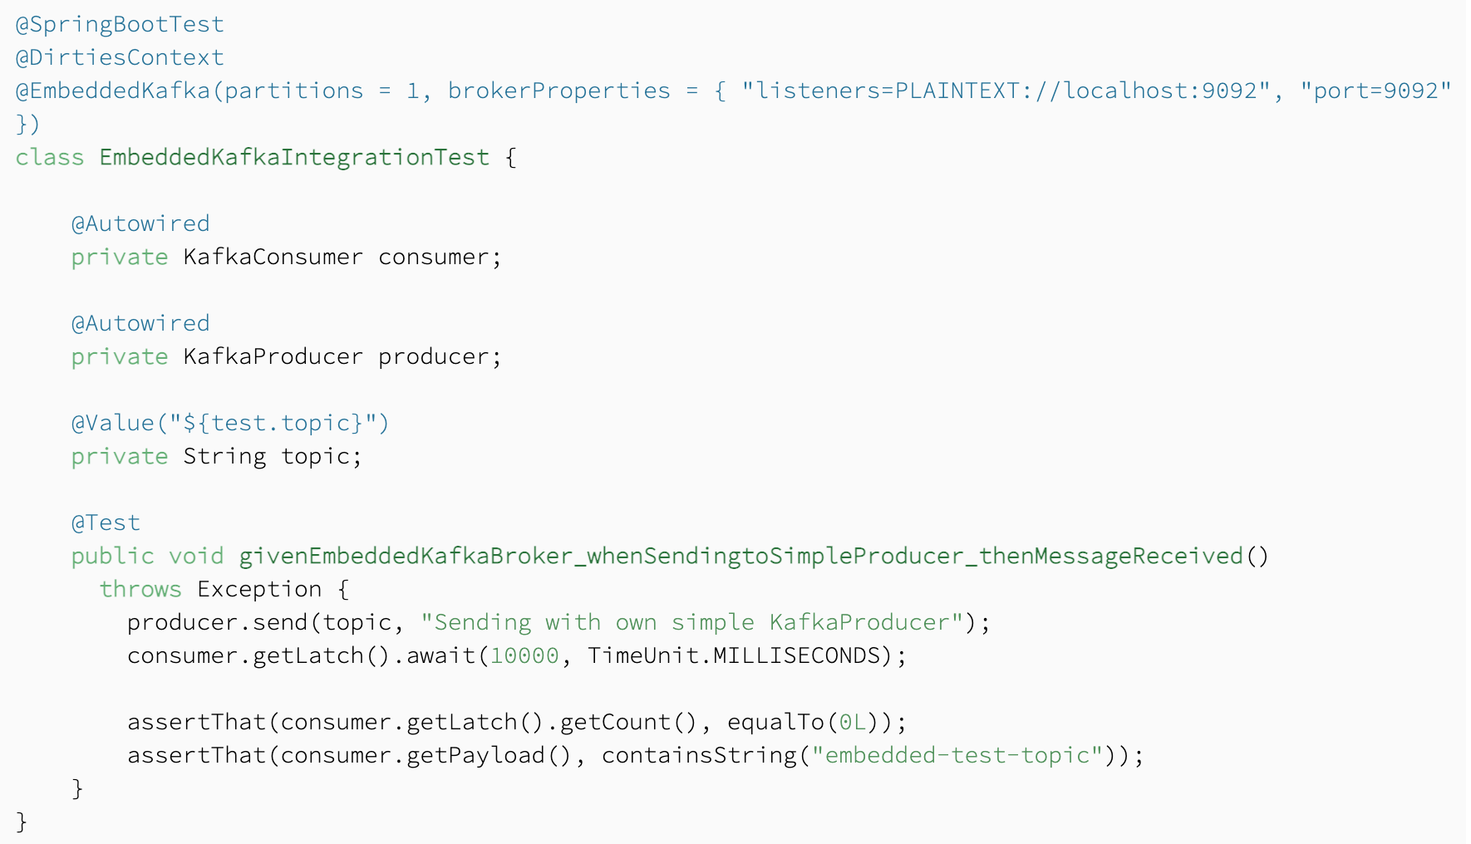
Testing: Spring Kafka
Notes:
https://www.baeldung.com/spring-boot-kafka-testing

Slide 110
Testing: Spring Kafka
https://www.baeldung.com/spring-boot-kafka-testing
Notes:
https://www.baeldung.com/spring-boot-kafka-testing

Slide 111

Testing: Test Containers
https://www.testcontainers.org/modules/kafka/
Notes:
https://www.testcontainers.org/modules/kafka/

Slide 112

Testing: Docker
Duh
Notes:
https://www.testcontainers.org/modules/kafka/

Slide 113

Testing
Notes:
Generaly these all test agains a real kafka.
So that comes at a cost of startup.
But it is easier then to just mock all that stuff.

Slide 114

Kafka Operators
Strimzi
Kubernetes Operator for Kafka
Used by Alphabet
Notes:
https://strimzi.io/docs/operators/latest/using.html

Slide 115
Kafka Operators: Topic Operator
Topic configuration in repo
The operator will create these
Also gives you more opportunities to manage security
Notes:
https://strimzi.io/docs/operators/latest/using.html
https://developer.ibm.com/components/kafka/tutorials/kafka-authn-authz/

Slide 116
Security
SSL Encryption
Note: pass along the encryption keys to your command lines
ACL
Command line tools for role base authorization on topics
Notes:
https://docs.confluent.io/platform/current/kafka/authentication_ssl.html https://cwiki.apache.org/confluence/display/KAFKA/Kafka+Authorization+Command+Line+Interface

Slide 117
Kafka vs Native Cloud solutions
Confluent Cloud (Cloud native Kafka)
AWS Kinesis
Azure Event Hubs
GCP Pub/Sub

Slide 118

Kafka vs Confluent Cloud
Kafka in the cloud
Billed for use
Multi-cloud
Notes:
https://www.confluent.io/confluent-cloud/compare-managed-kafka-services/
https://www.confluent.io/confluent-cloud/pricing/

Slide 119
Kafka vs AWS Kinesis
Kineses is modelled on Kafka
Message retention max 7 days
Max message size 1Mb
Fixed replication of 3
Easier to setup
Kafka can be made more performant
Notes:
https://www.softkraft.co/aws-kinesis-vs-kafka-comparison/#what-is-amazon-kinesis
https://www.xplenty.com/blog/amazon-kinesis-vs-kafka/

Slide 120
Kafka vs Azure Event Hubs
Event hub instance = Topic
No Transaction support
Easier to setup
Limits to message size
Notes:
https://www.codit.eu/blog/getting-familiar-with-azure-event-hubs-for-apache-kafka/?country_sel=be

Slide 121
Kafka vs GCP Pub Sub Lite
No Transaction support and log compaction
More similar to Kafka then Pub Sub
Limits to message size
Can be used with Kafka Clients
For Streams: use Apache Beam or Dataflow
Notes:
https://medium.com/google-cloud/google-pub-sub-lite-for-kafka-users-dec8a7cfc5e5
https://cloud.google.com/pubsub/docs/choosing-pubsub-or-lite

Slide 122
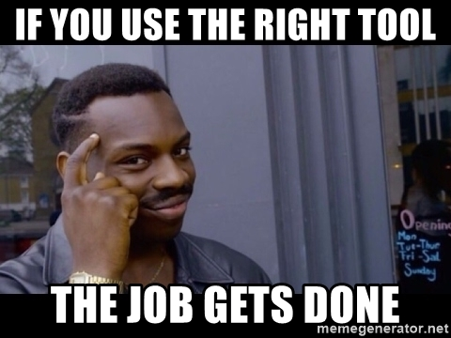
Using Kafka: just as important
Notes:
https://medium.com/google-cloud/google-pub-sub-lite-for-kafka-users-dec8a7cfc5e5
https://cloud.google.com/pubsub/docs/choosing-pubsub-or-lite

Slide 123
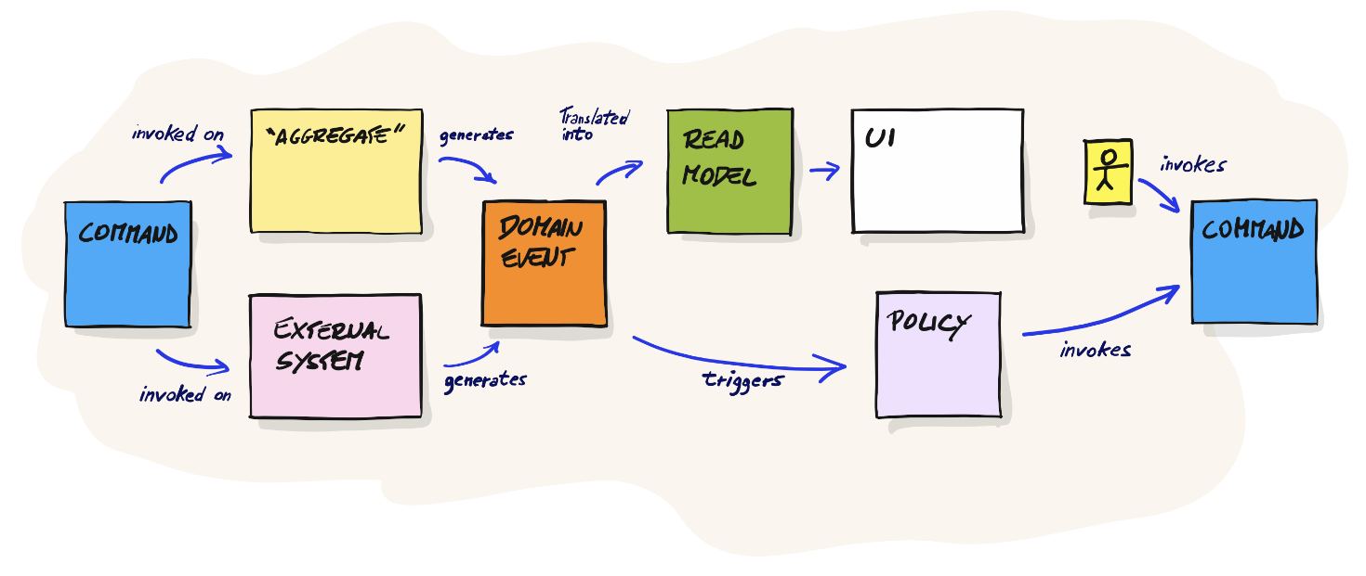
Using Kafka: just as important
Notes:
https://medium.com/google-cloud/google-pub-sub-lite-for-kafka-users-dec8a7cfc5e5
https://cloud.google.com/pubsub/docs/choosing-pubsub-or-lite

Slide 124
Hints and Tips
How kafka consumers connect and what happens if it takes too long (all on 1 thread)
Issues and warnings
Lots of warning logs in the brokers is not good

Slide 125
Hints and Tips
Increase default message size
Update broker: max message size
Update consumer config: max bytes to consume
Update producer config: max bytes to produce

Slide 126
Session windows: Traffic Congestion
Notes:
Interactive whiteboard session to show what you could do with a session window on the current dataset. => merge results into single data point for entire highway section (all lanes and all vehicles) => if average speed < 50 km => traffic jam => send this out to another topic => apply session window with a gap of 5 minutes => aggregate results: vehicle count => resulting output should give you the amount of vehicles involved within a traffic jam
=> Because you also know the length of every given session you should also be able to know how long it lasted.

Slide 127
Session windows: Traffic Congestion
Notes:
Interactive whiteboard session to show what you could do with a session window on the current dataset. => merge results into single data point for entire highway section (all lanes and all vehicles) => if average speed < 50 km => traffic jam => send this out to another topic => apply session window with a gap of 5 minutes => aggregate results: vehicle count => resulting output should give you the amount of vehicles involved within a traffic jam
=> Because you also know the length of every given session you should also be able to know how long it lasted.

Slide 128
Session windows: Traffic Congestion
Merge results of all lanes
If average speed < 50km => slow traffic
To: slow-traffic-topic
@Input slow-traffic-topic => session window with gap of 5 minutes
Aggregate results: vehicle count
To: vehicles-involved-in-traffic-jam
Because the session window also has a start and end time
=> length of the traffic jam
Notes:
Interactive whiteboard session to show what you could do with a session window on the current dataset. => merge results into single data point for entire highway section (all lanes and all vehicles) => if average speed < 50 km => traffic jam => send this out to another topic => apply session window with a gap of 5 minutes => aggregate results: vehicle count => resulting output should give you the amount of vehicles involved within a traffic jam
=> Because you also know the length of every given session you should also be able to know how long it lasted.

Slide 129
Thank you for attending!

